Slide 1
walkthrough vertical prototype

Slide 2
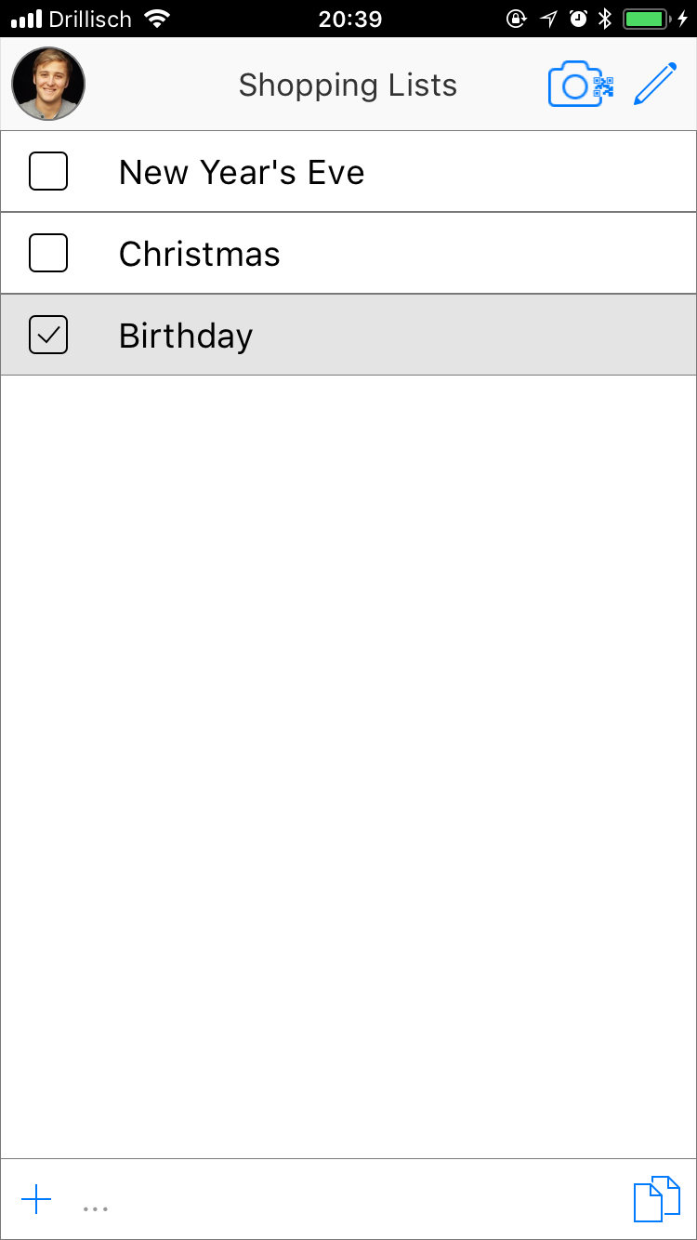
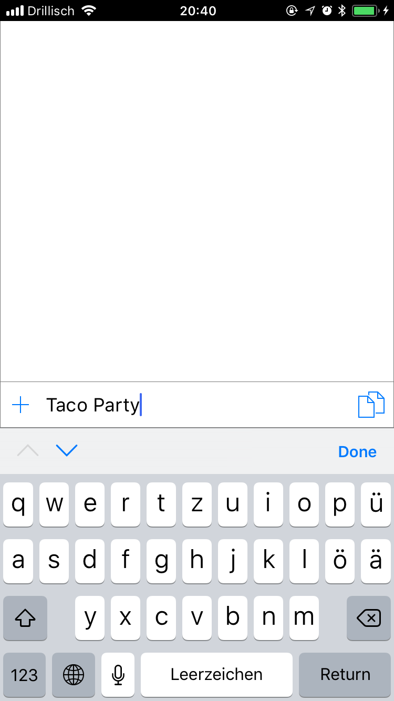
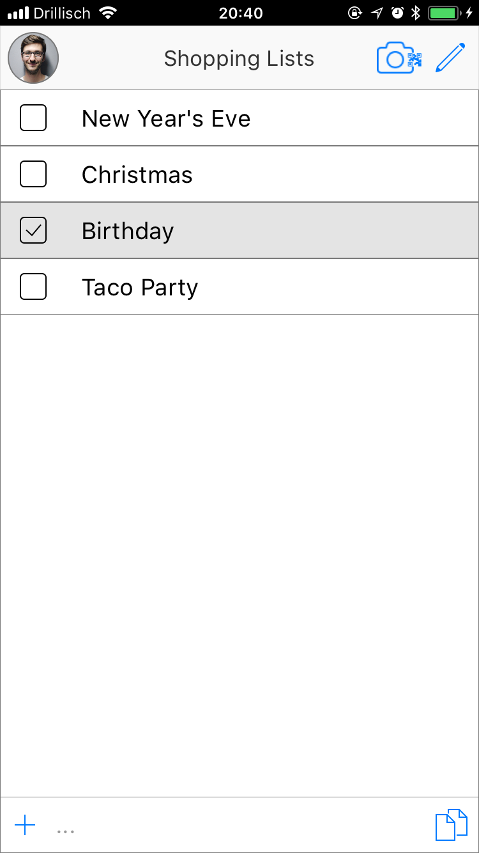
Home Screen with all existing shopping lists.
Add a list by typing a name in the text field at the bottom of the screen and confirm „Done“ or „Return“.

Slide 3
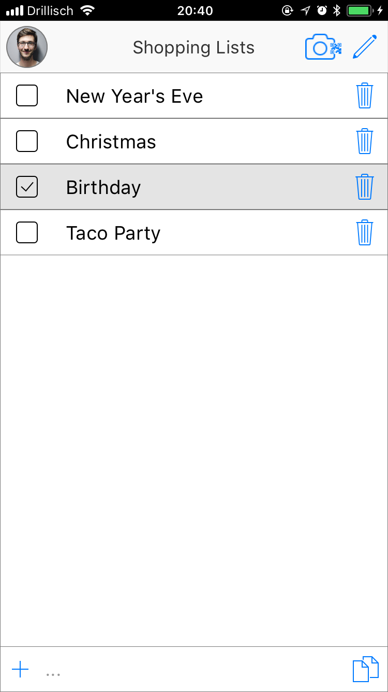
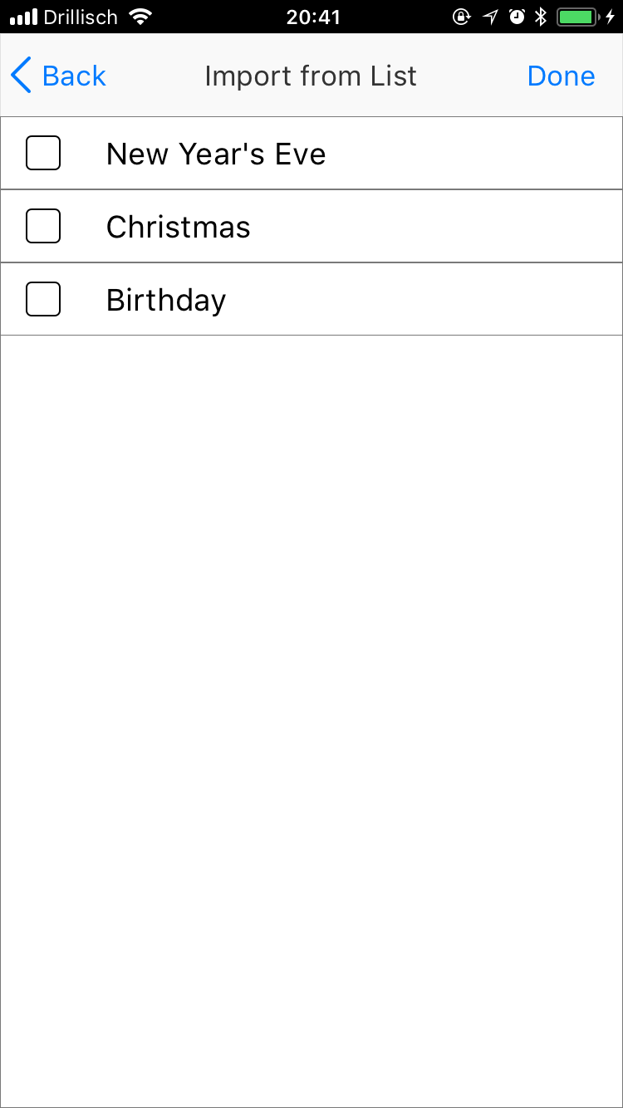
Delete lists by activating the edit mode (pen in the top of the screen) and hit the trash can symbol next to the list you want to delete.

Slide 4
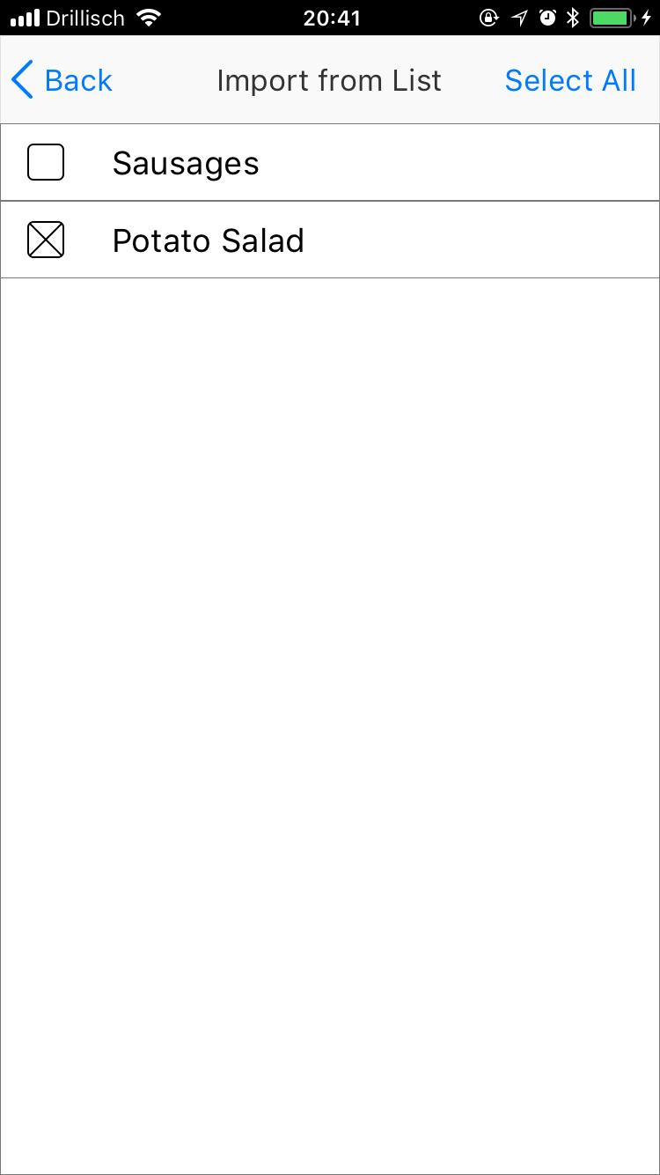
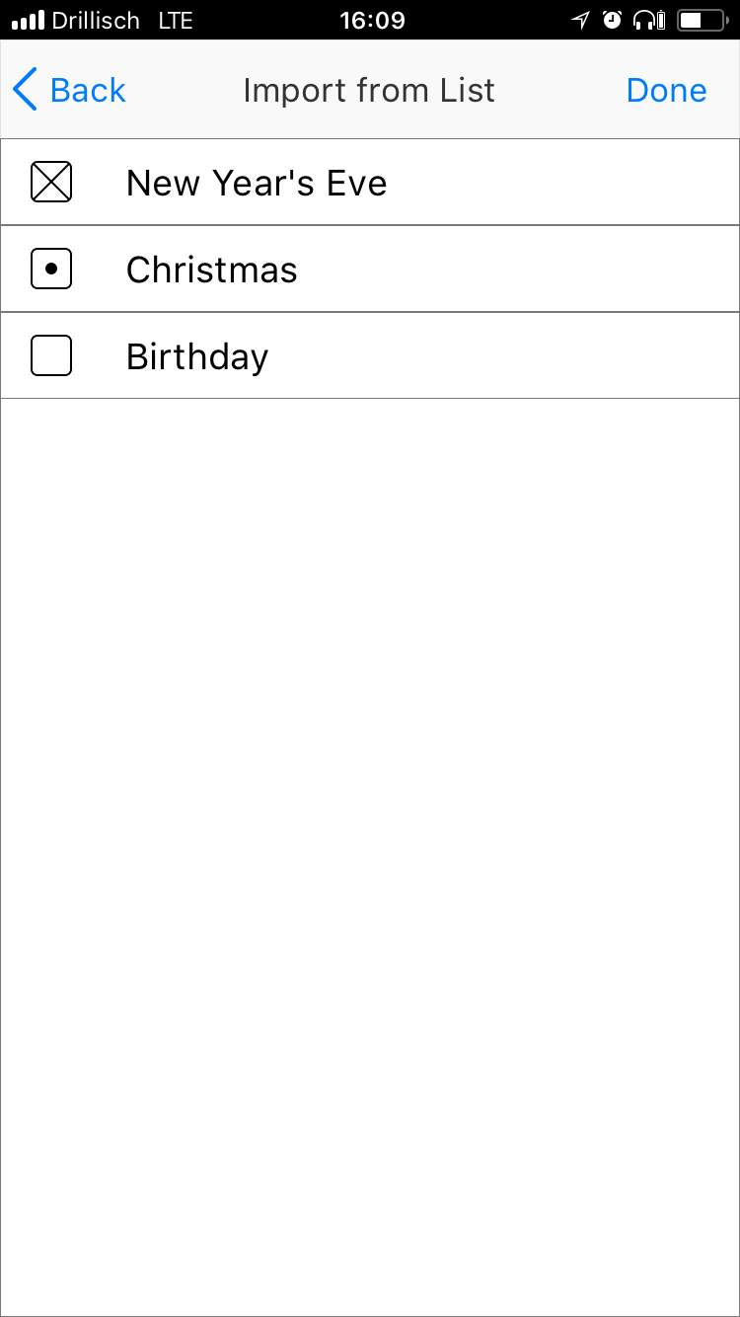
Create a new list with exisiting items by pressing the button in the right bottom
Add single items from a list (Potato Salad from the New Year‘s Eve list) by going in the list and checking the items. Lists that are chosen partially are marked with a „.“ int the list overview.
Alternatively chose all items in a list by checking the box in the left. These will be marked with an „x“.
Press „Done“ to add the new list to your home screen.

Slide 5
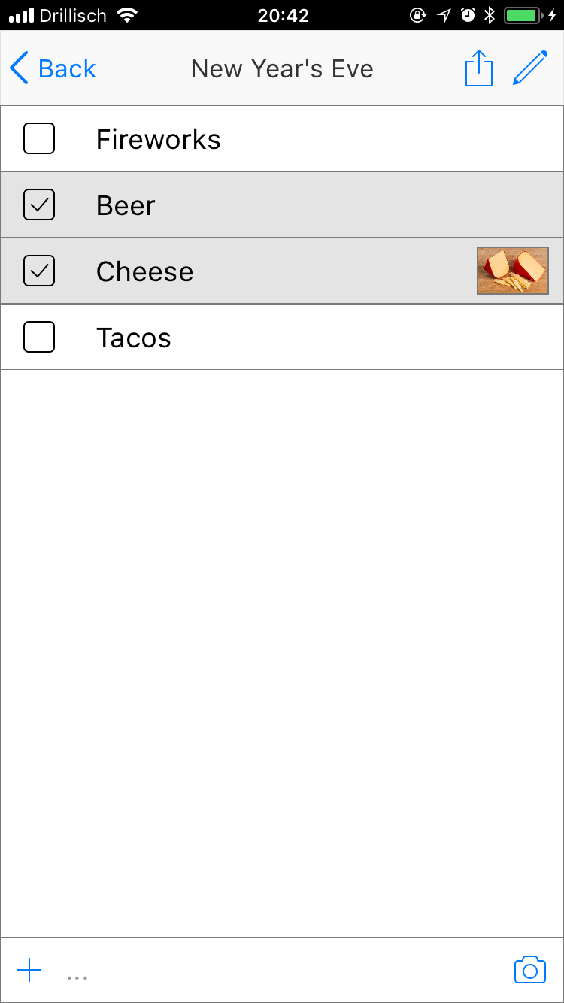
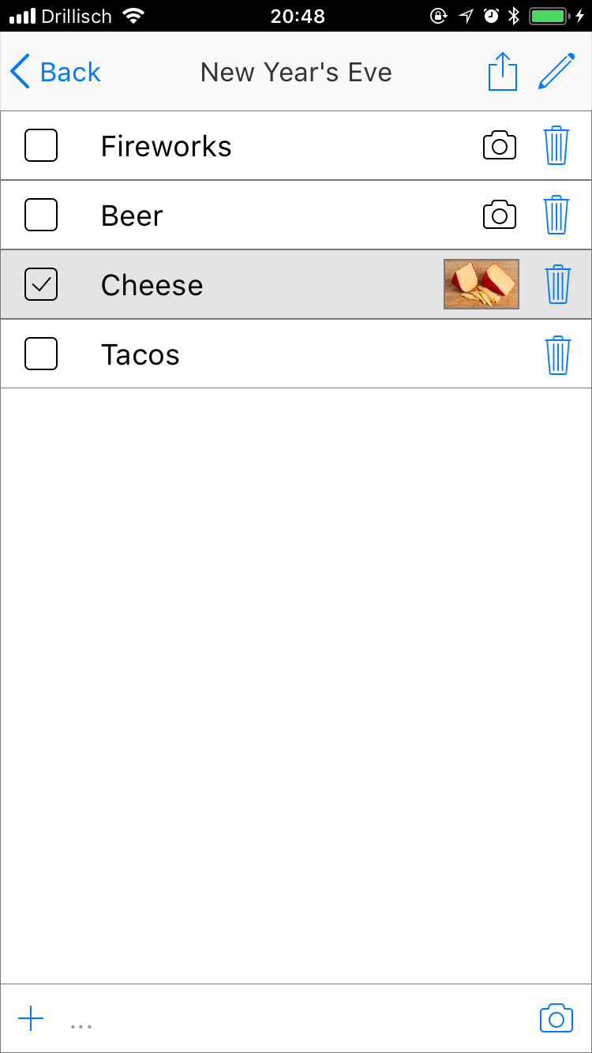
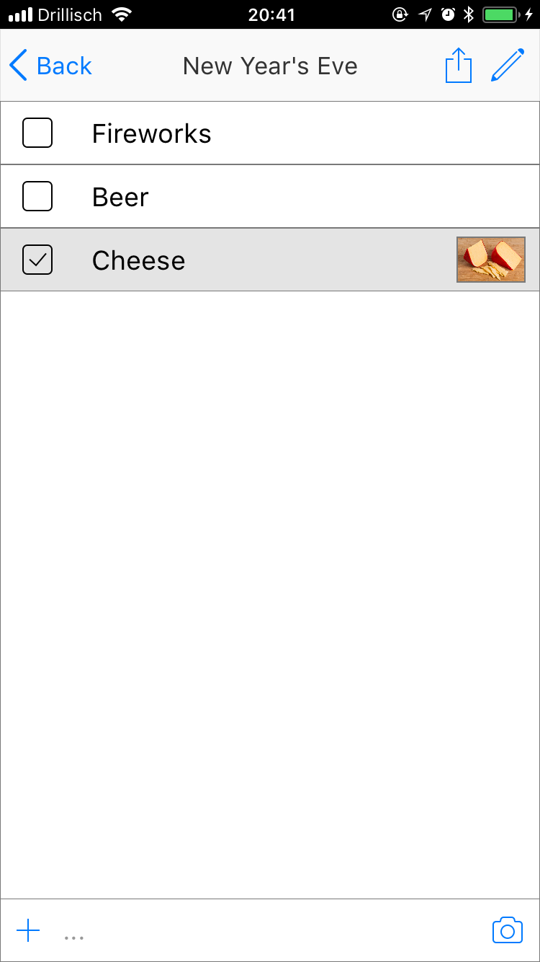
Open a list by tapping on it. (Example is new Year‘s Eve)
Open the edit mode with the „pen“ button. Now you can delete items with the trash can, rename them and add pictures with camera button.

Slide 6

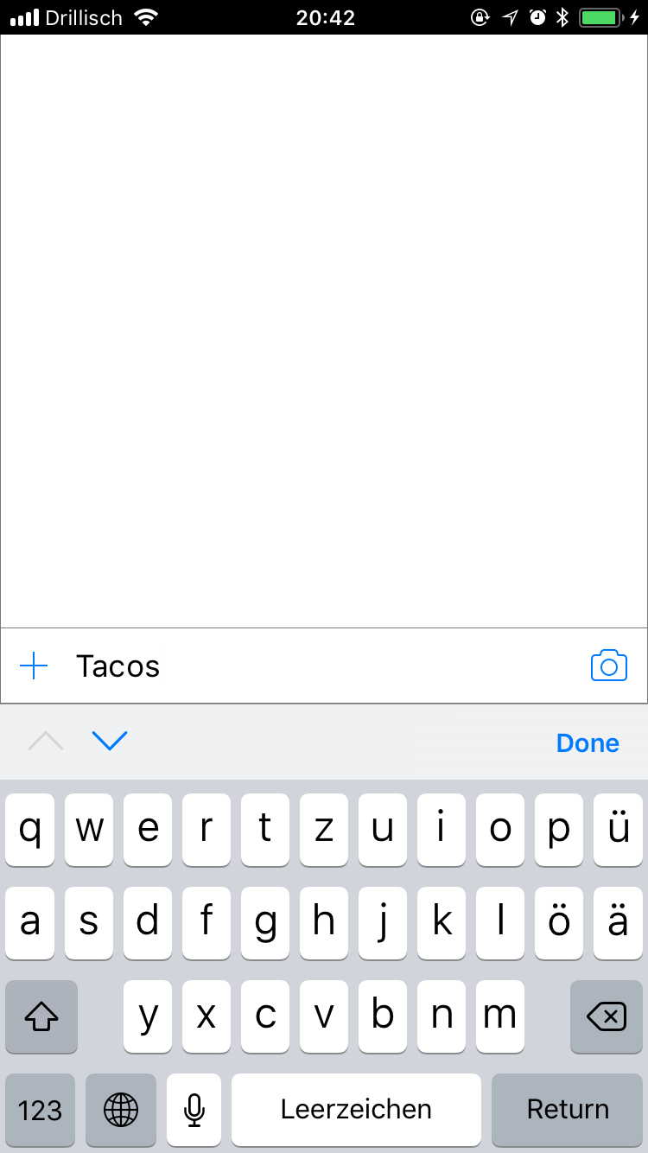
Add an item with only a name by typing the name in the text field in the bottom and confirm „Done“ or „Return“.

Slide 7
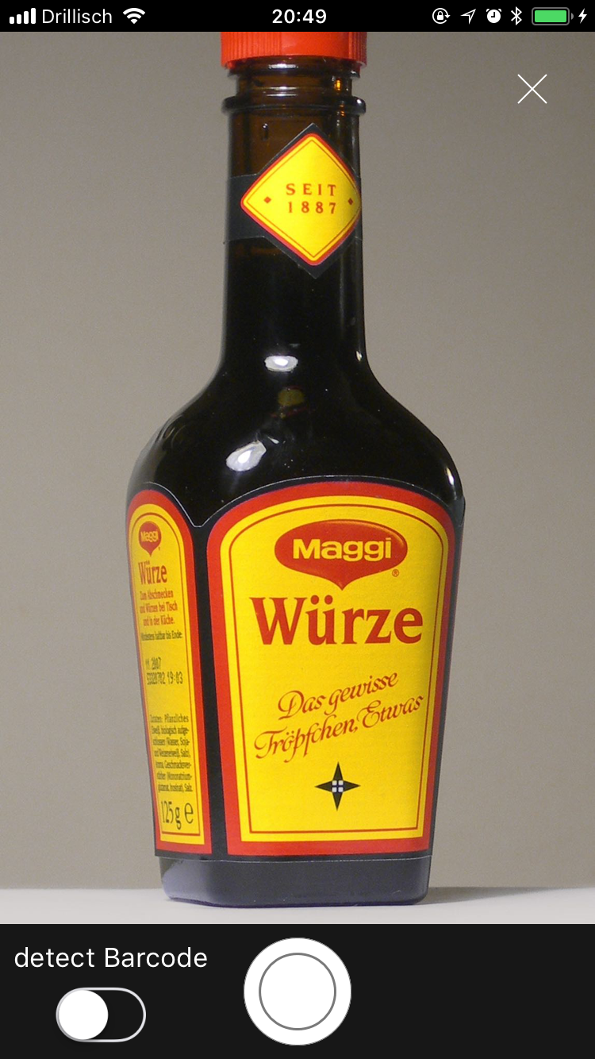
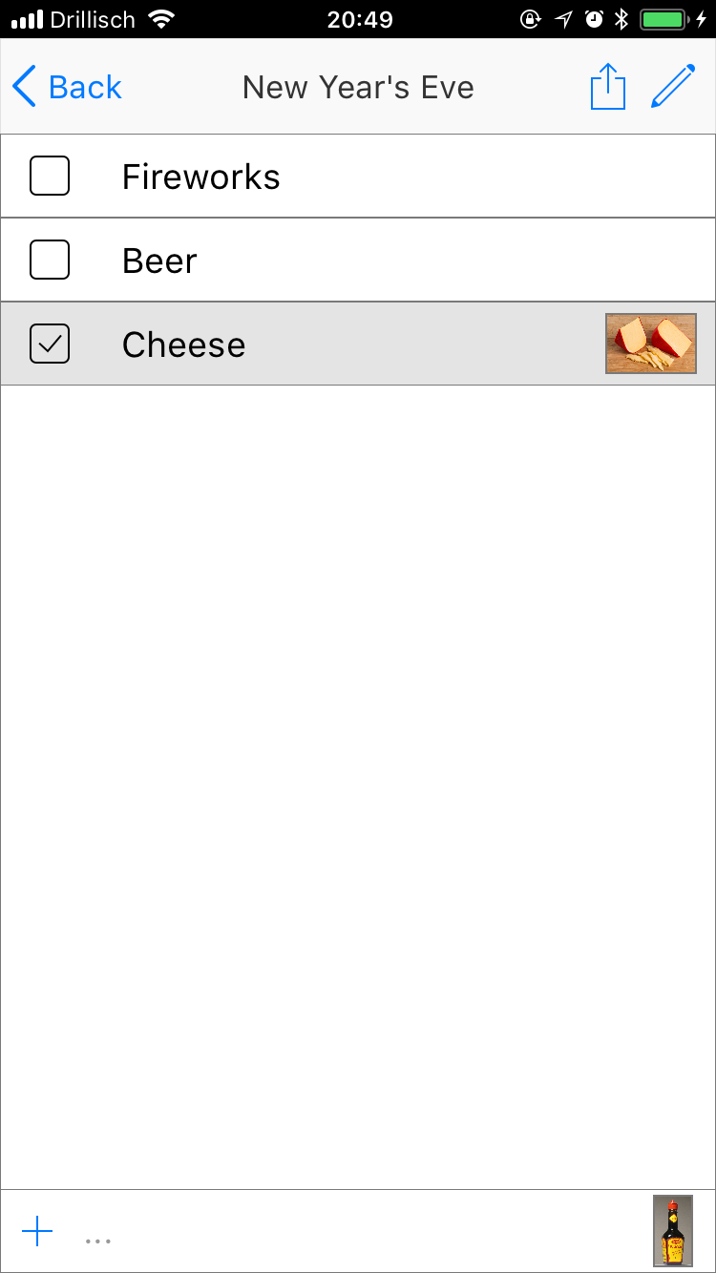
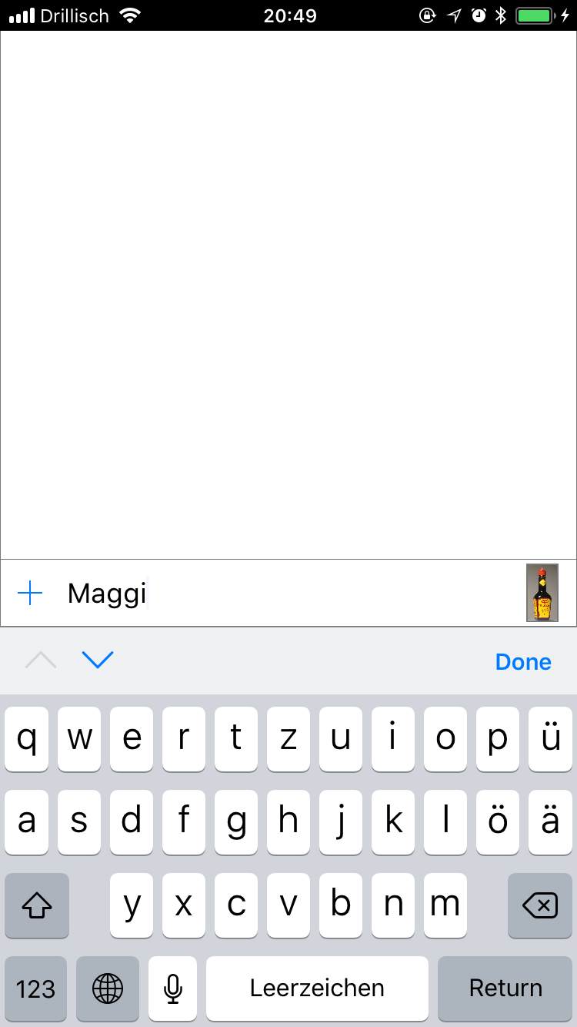
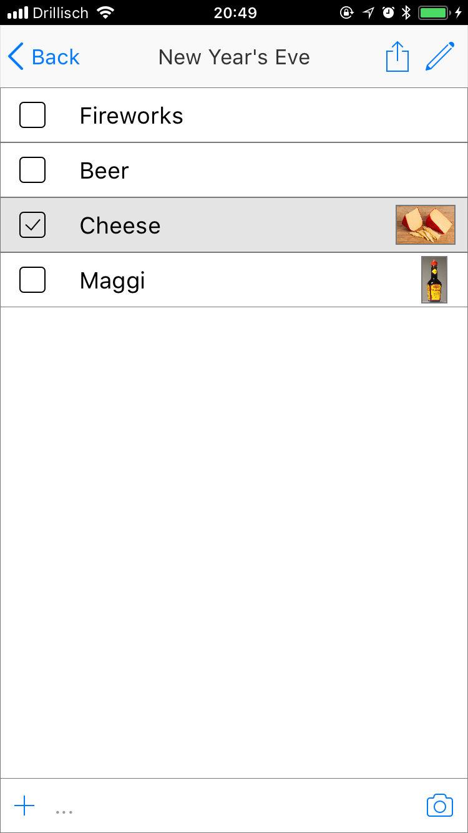
Add an item with a picture by tapping the camera button, taking a picture, typing the name and then confirm with „Done“ or „Return“.

Slide 8
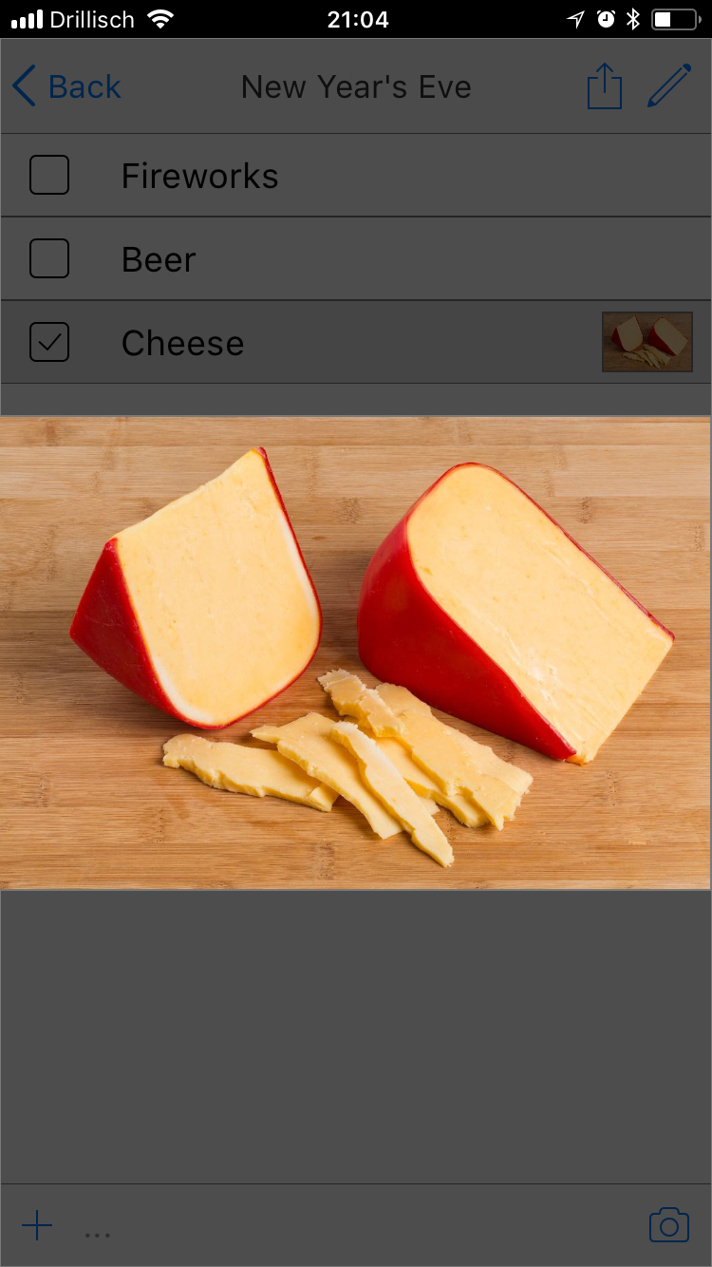
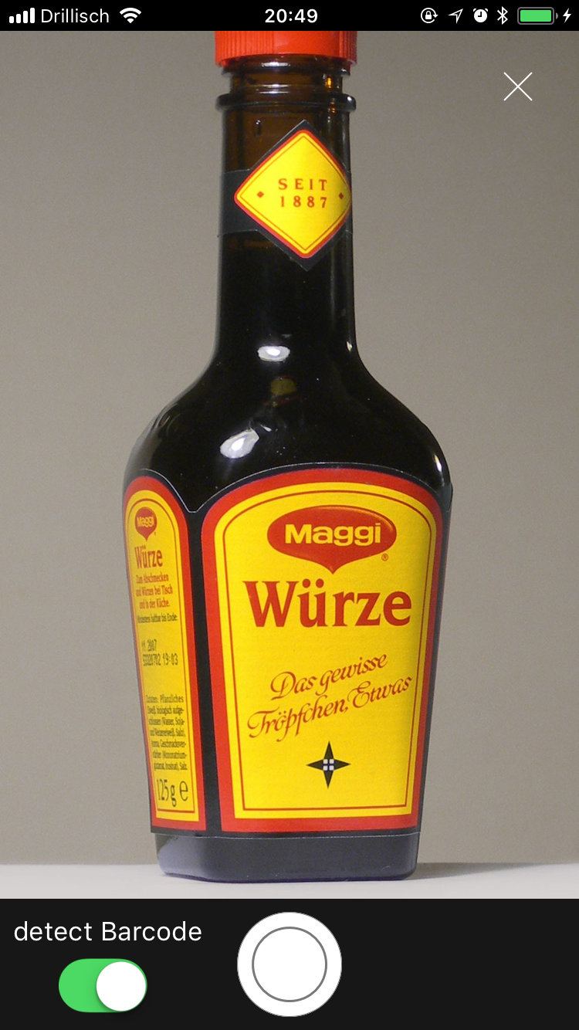
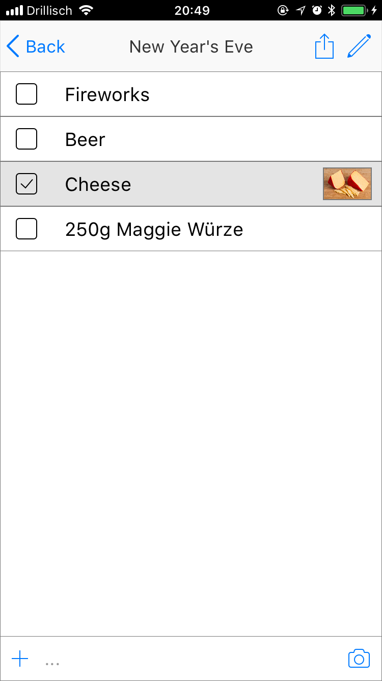
Tap on a picture to view it in fullscreen. Tap again to go back.
Instead of adding an item manually one can also scan the barcode by checking the „detect Barcode“ slider in the camera screen.

Slide 9
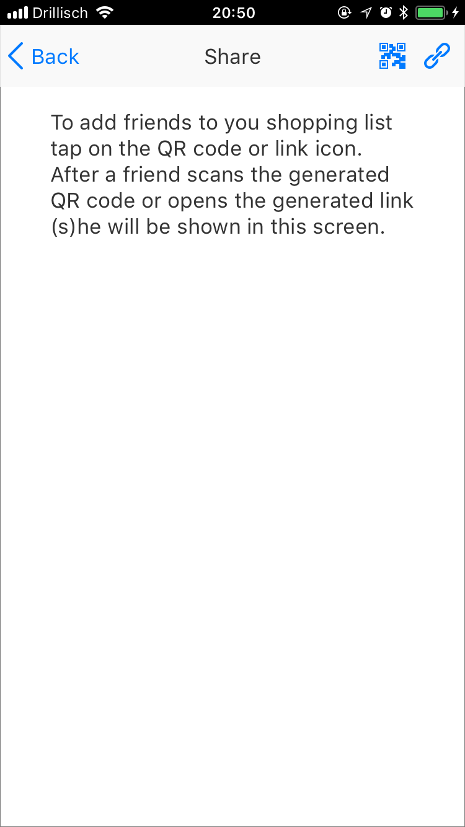
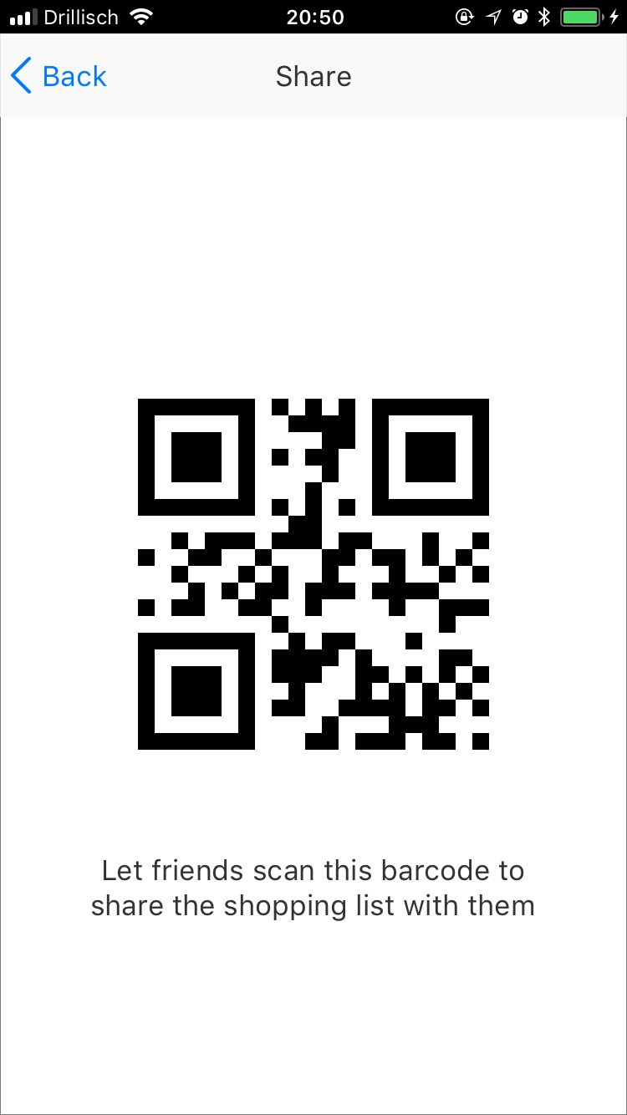
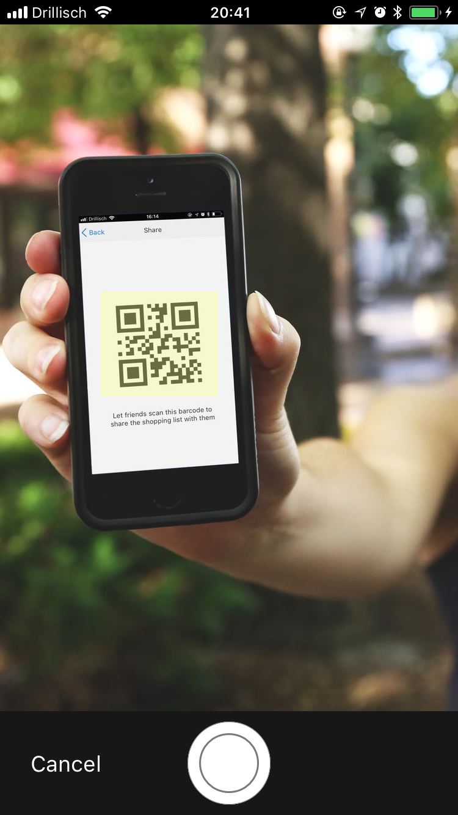
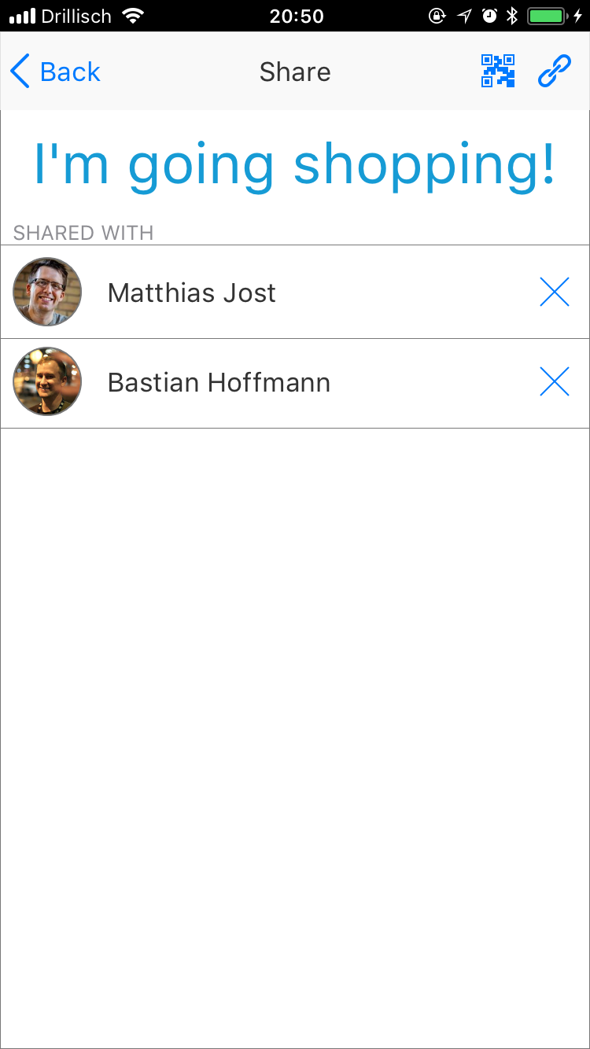
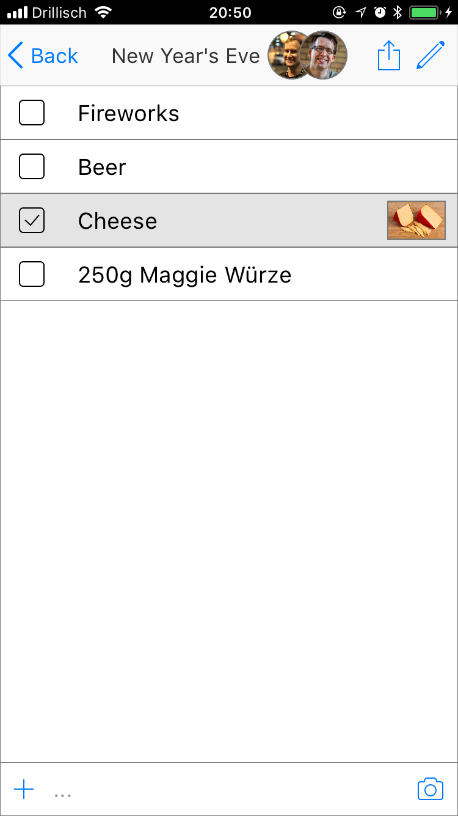
To invite friends to share you shopping list with you have to tap the share button next to the pen in a shopping list to open the share screen. There you tap the QR Code button at the top of the display to create a QR code and let your friends scan it. Afterwards they will be displayed in the share screen and appear in the top bar of the shopping lists you shared with them.

Slide 10
To join a friends shopping list you have to go to the home screen and hit the Camera symbol with a QR Code attached at the top. Then you just have to hold the phone over the QR code.

Slide 11
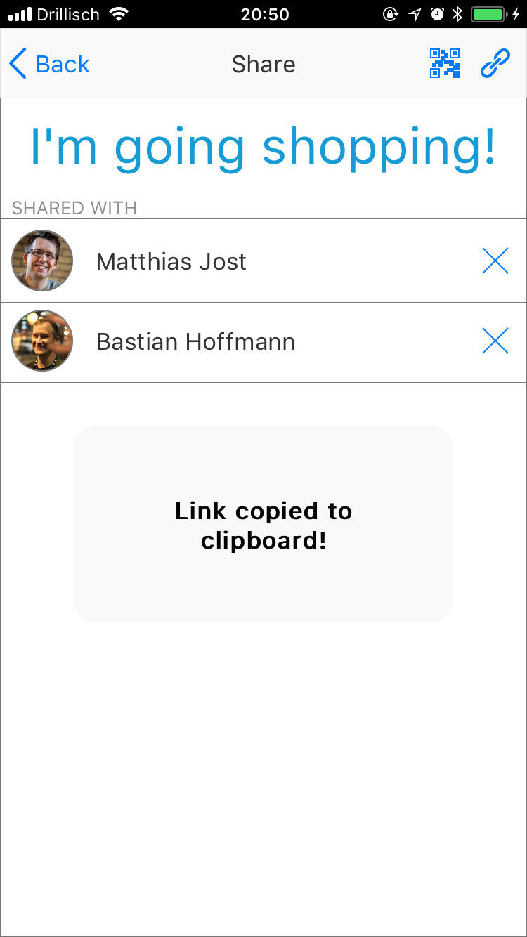
Instead of using the QR Code you can also invite friend with a link by pressing the link symbol next to the QR code button in the share screen. That will create an invitation link, which you can send people you want to share the list with, and copy it to your clipboard.

Slide 12
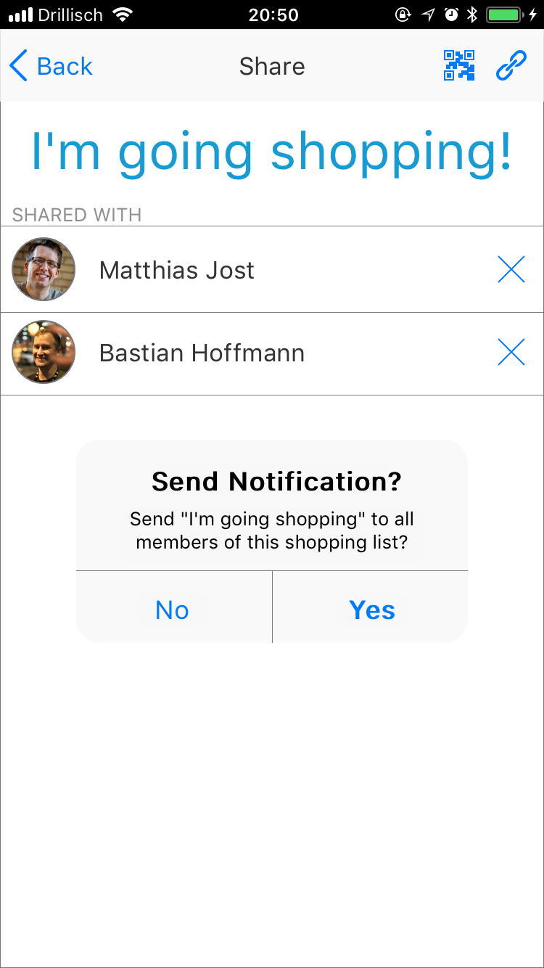
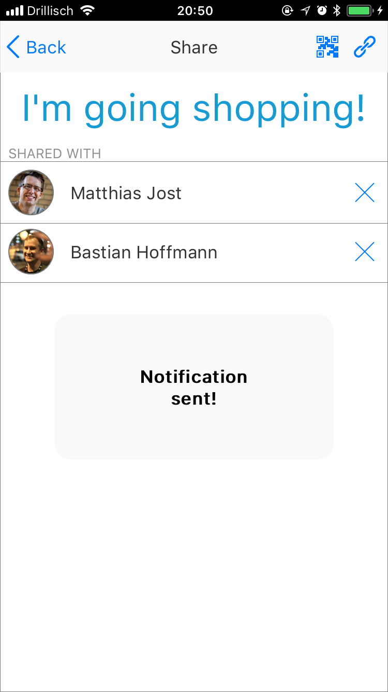
To send a notification click on the „I‘m going shopping!“ button and confirm with yes.

Slide 13
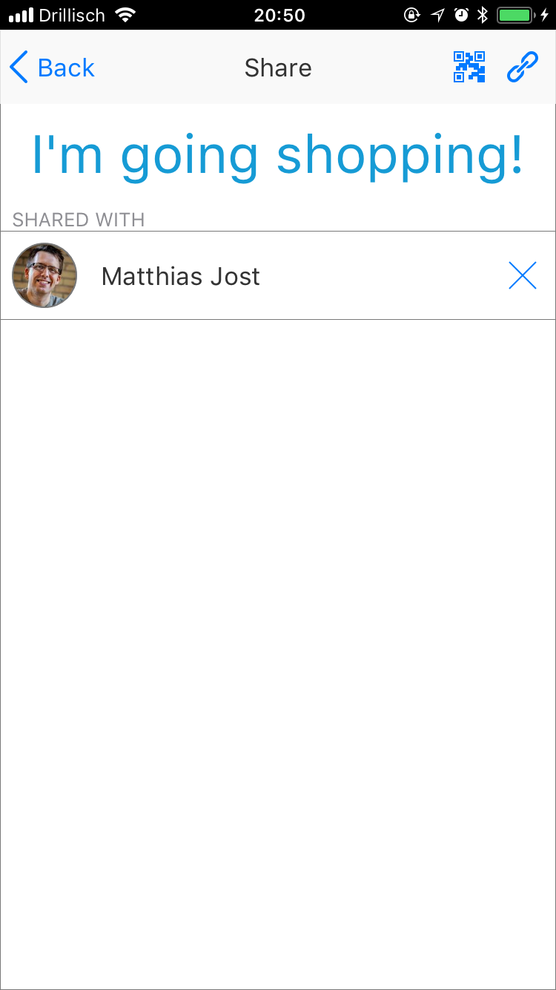
Delete contacts from a list with the „x“ on the right.

Slide 14
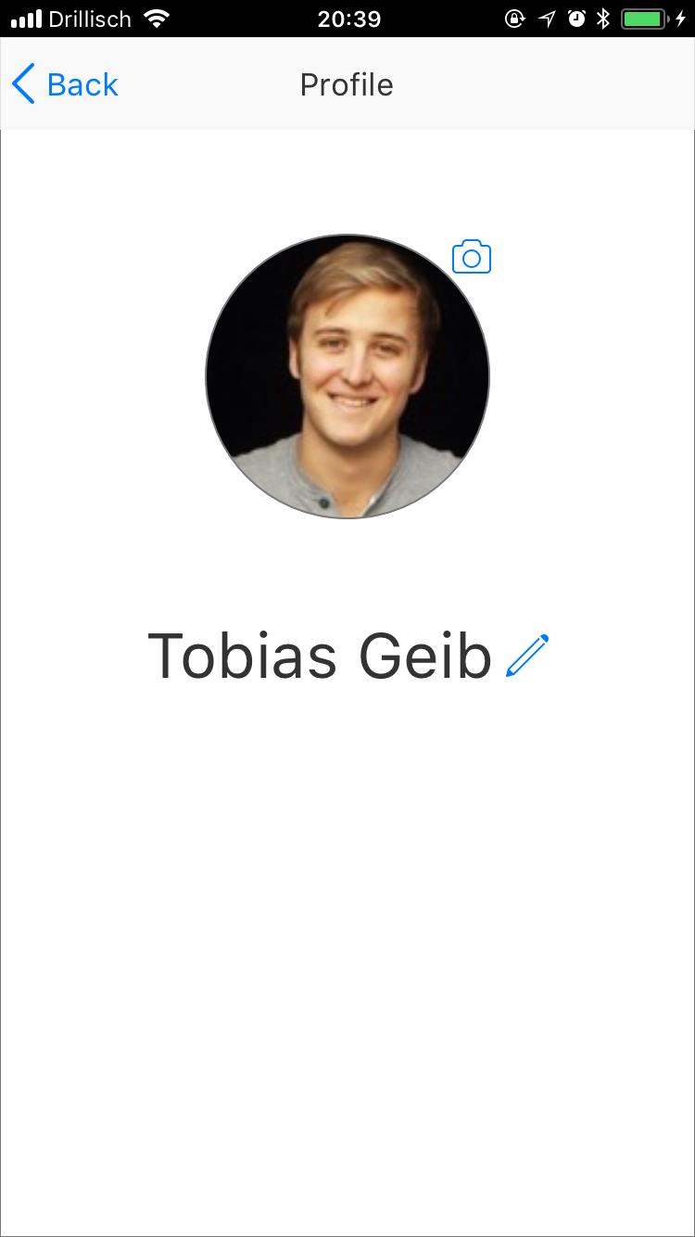
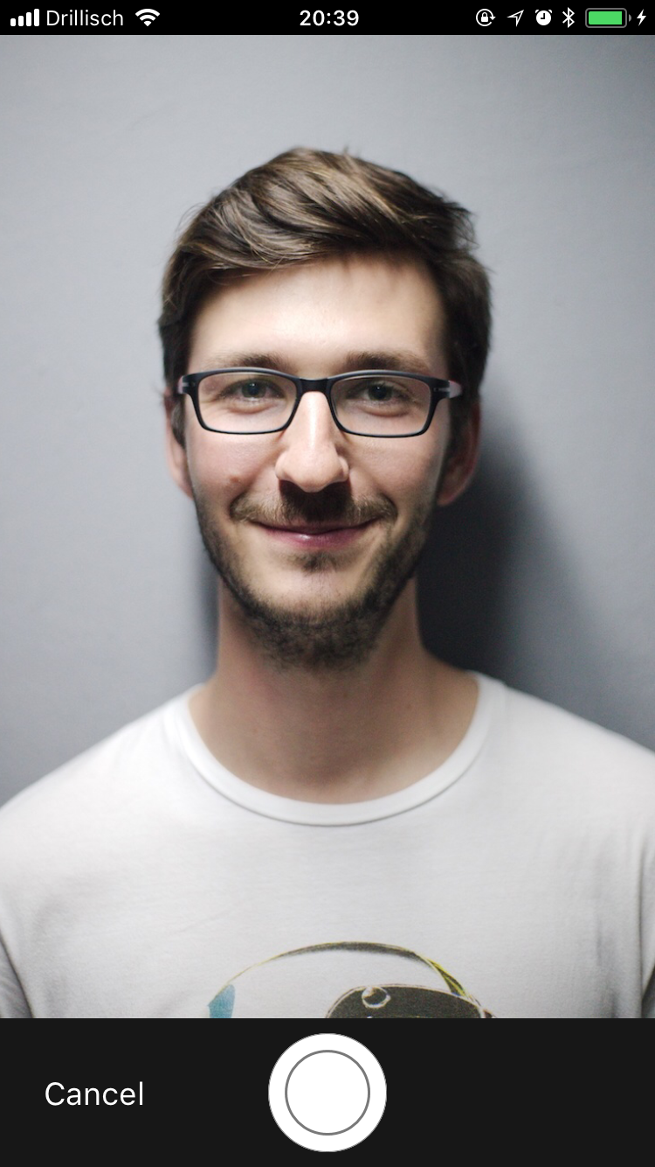
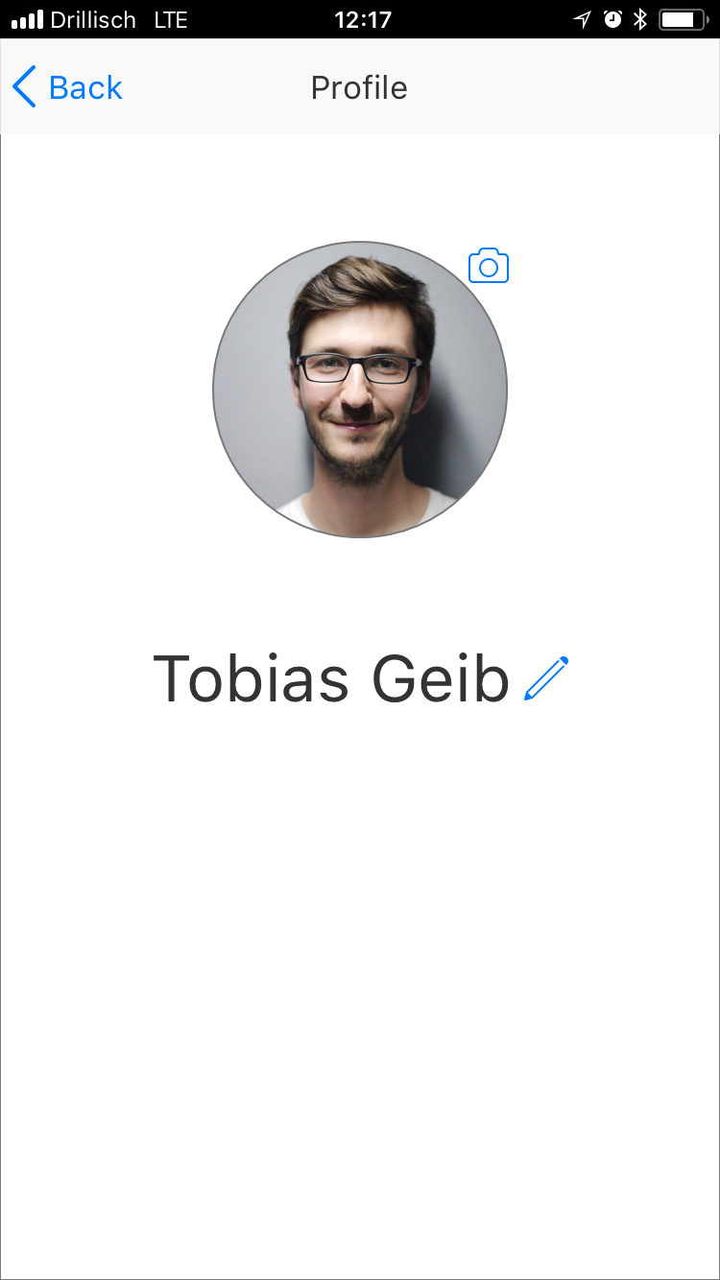
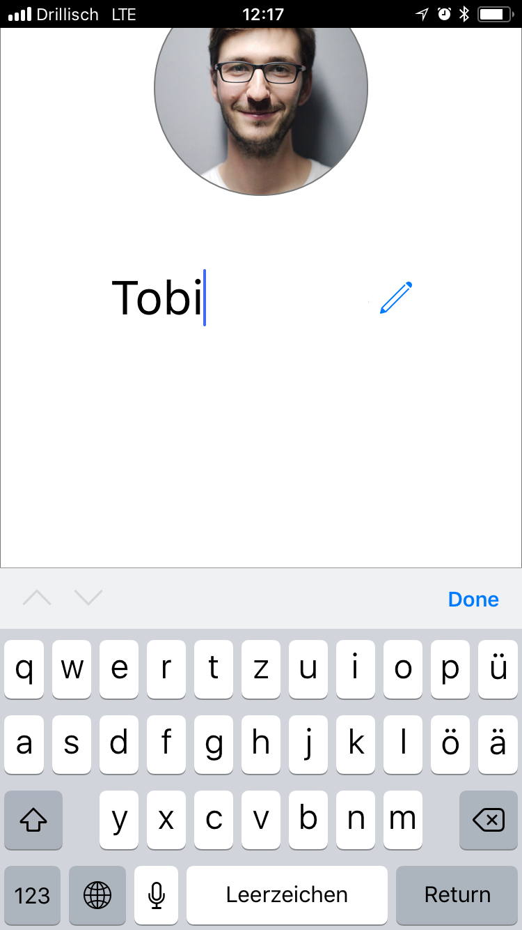
Edit your Profile information with the camera button, to change your picture, and the pen to change your name.

